Slide 1
Infection
Control and Prevention

Slide 2
What is a Bloodborne Pathogens?
Pathogens include but are not limited to:
Hepatitis B
HIV – human immunodeficiency virus
Answer = microorganisms that are present in human blood or other potentially infectious materials and can cause disease in humans.

Slide 3
Why the concern?
OSHA estimates 5.6 million workers in healthcare are at risk of exposure to bloodborne pathogens such as human immunodeficiency (HIV) and hepatitis B virus

Slide 4
What is an Occupational Exposure?
…contact with blood or other potentially infectious materials that may result from the performance of an employee’s duties.
Duties may include:
Direct Patient Care
Phlebotomy/Laboratory
Environmental Services
Waste Management
Other

Slide 5
All West Cancer Center Associates and Volunteers will use Standard (universal) Precautions
What does that mean?
Standard precautions are a set of infection control practices used to prevent transmission of diseases that can be acquired by contact with blood, body fluids, non-intact skin (including rashes), and mucous membranes.
Go to this website and read World Health Organization materials on Standard Precautions.
http://www.who.int/csr/resources/publications/EPR_AM2_E7.pdf

Slide 6
Standard Precautions include
Hand hygiene
Personal Protective Equipment
Needle stick and Sharps Injury Prevention
Cleaning and Disinfection
Respiratory Hygiene (Cough Etiquette)
Waste Disposal
Safe Injection Practices

Slide 7
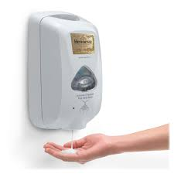
Hand Hygiene
Using Alcohol-Based Hand Rub (Preferred Method)
Using Alcohol-based Hand Rub (follow manufacturer’s directions):
Dispense the recommended volume of product
Apply product to the palm of one hand
Rub hands together, covering all surfaces of hands and fingers until they are dry (no rinsing is required)

Slide 8
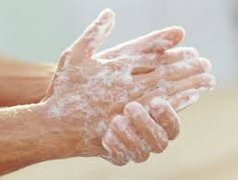
Handwashing with Soap and Water
Method for when hands are visibly soiled or after caring for patients with known or suspected infectious diarrhea.
Wet hands first with water (avoid using hot water)
Apply soap to hands
Rub hands vigorously for at least 15 seconds, covering all surfaces of hands and fingers
Rinse hands with water and dry thoroughly with paper towel
Use paper towel to turn off water faucet

Slide 9
Indications for Hand Hygiene
Always perform hand hygiene in the following situations.
Before touching a patient, even if gloves will be worn
Before exiting the patient’s care area after touching the patient or the patient’s immediate environment
After contact with blood, body fluids or excretions, or wound dressings
Prior to performing an aseptic task (e.g., accessing a port, preparing an injection)
If hands will be moving from a contaminated-body site to a clean-body site during patient care
After glove removal

Slide 10
Personal Protective Equipment (PPE)
Use of PPE - Gloves
Wear gloves when there is potential contact with blood (e.g., during phlebotomy), body fluids, mucous membranes, non-intact skin or contaminated equipment.
Wear gloves that fit appropriately (select gloves according to hand size)
Do not wear the same pair of gloves for the care of more than one patient.
Do not wash gloves for the purpose of reuse.
Perform hand hygiene before and immediately after removing gloves.

Slide 11
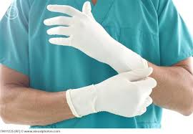
More about Wearing Gloves
Fresh gloves must be put on immediately before undertaking a procedure and removed immediately after it.
If they are put on before collecting equipment they will become contaminated. Equipment should therefore be collected first and placed at the patient's bedside ready for use.
Gloves should be kept in their original box, and taken from it as and when required. They must not be decanted into an open container, and they must not be put in uniform pockets.
Boxes of gloves must not be stored on windowsills

Slide 12
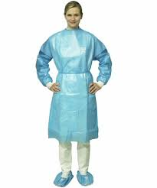
Use of PPE - Gowns
Wear a gown to protect skin and clothing during procedures or activities where contact with blood or body fluids is anticipated.
Do not wear the same gown for the care of more than one patient
Remove gown and perform hand hygiene before leaving the patient’s environment (e.g., exam room)

Slide 13
Use of PPE - Facemasks
Wear a facemask:
When there is potential contact with respiratory secretions and sprays of blood or body fluids
May be used in combination with goggles or face shield to protect the mouth, nose and eyes
When placing a catheter or injecting material into the spinal canal or subdural space (to protect patients from exposure to infectious agents carried in the mouth or nose of healthcare personnel)
Wear a facemask to perform intrathecal chemotherapy

Slide 14
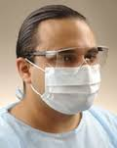
Use of PPE - Goggles, Face Shields
Wear eye protection for potential splash or spray of blood, respiratory secretions, or other body fluids.
Personal eyeglasses and contacts are not considered adequate eye protection

Slide 15
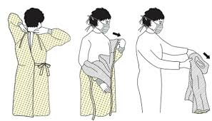
Watch the video
Proper Ways to Don and Remove PPE
https://www.youtube.com/watch?v=oxdaSeq4EVU&ebc=ANyPxKqgMlHsO7qMxhji4gUtQadkUCTqUty6w19QjfnywX8wIoo7CHHMA-VLdfdiyzeDssSBcb708mAEZy4Ap9nhhSBmjbZkyQ&nohtml5=False

Slide 16
Key Points to Donning PPE
Always perform hand hygiene before donning PPE
If wearing a gown, don the gown first and fasten in back accordingly
If wearing a facemask or respirator:
Secure ties or elastic band at the back of the head and/or neck
Fit flexible band to nose bridge
Fit snug to face and below chin
If wearing goggles or face shield, put it on face and adjust to fit
If wearing gloves in combination with other PPE, don gloves last

Slide 17
Key Points to Removing PPE
Remove PPE before leaving the exam room or patient environment (except respirators which should be removed after exiting the room)
Removal of gloves:
Grasp outside of glove with opposite gloved hand; peel off
Hold removed glove in glove hand
Slide ungloved fingers under the remaining glove at the wrist; peel off and discard
Removal of gowns:
Remove in such a way to prevent contamination of clothing or skin
Turn contaminated outside surface toward the inside
Roll or fold into a bundle and discard

Slide 18
Removal of Face Mask, Respirator, Goggles or Face Shield
Avoid touching the front of the mask or respirator
Grasp the bottom and the ties/elastic to remove and discard
Removal of goggles or face shield
Avoid touching the front of the goggles or face shield
Remove by handling the head band or ear pieces and discard
Always perform hand hygiene immediately after removing PPE

Slide 19
Respiratory Hygiene and Cough Etiquette
Identifying Persons with Potential Respiratory Infection
Facility staff remain alert for any persons arriving with symptoms of a respiratory infection
Signs are posted at the reception area instructing patients and accompanying persons to:
Self-report symptoms of a respiratory infection during registration
Practice respiratory hygiene and cough etiquette (technique described below) and wear facemask as needed

Slide 20
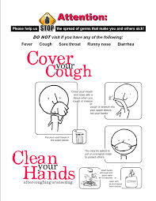

Slide 21
Availability of Supplies
The following supplies are provided in the reception area and other common waiting areas:
Facemasks, tissues, and no-touch waste receptacles for disposing of used tissues
Dispensers of alcohol-based hand rub

Slide 22
All persons with signs and symptoms of a respiratory infection (including facility staff) are instructed to:
Cover the mouth and nose with a tissue when coughing or sneezing;
Dispose of the used tissue in the nearest waste receptacle
Perform hand hygiene after contact with respiratory secretions and contaminated objects/materials

Slide 23
Specific infection prevention practices

Slide 24
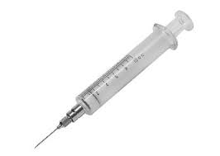
Safe Injection Practices
Use aseptic technique when preparing and administering chemotherapy infusions or other parenteral medications.
Avoid prefilling and storing batch-prepared syringes except in accordance with pharmacy standards
Avoid unwrapping syringes prior to the time of use
Never administer medications from the same syringe to multiple patients, even if the needle is changed or the injection is administered through an intervening length of intravenous tubing
Do not reuse a syringe to enter a medication vial or solution

Slide 25
Do not administer medications from single-dose or single-use vials, ampoules, or bags or bottles of intravenous solution to more than one patient (e.g, do not use a bag of saline as a common source supply for multiple patients)
Cleanse the access diaphragms of medication vials with 70% alcohol and allow the alcohol to dry before inserting a device into the vial
Dispose of used syringes and needles at the point of use in a sharps container that is closable, puncture-resistant, and leak-proof

Slide 26
Phlebotomy Procedures
Phlebotomy procedures are performed in a dedicated area, if possible
If the procedure has to be done elsewhere (e.g., exam room, chemotherapy suite), do not bring common trays of supplies for phlebotomy or intravenous device access to the patient’s immediate treatment area; bring only the necessary supplies to the patient side
Use aseptic technique to perform the phlebotomy procedure
Do not reuse vacutainer holders
Minimize environmental contamination by performing the following:
Label tubes before blood is drawn
Avoid placing tubes on patient charts or other items or surfaces that cannot be properly cleaned
Do not process or store blood specimens near medications or medication preparation area

Slide 27
Medication Storage
Store medications that require refrigeration in a dedicated, labeled refrigerator that meets requirements for such storage (e.g., thermostat control, separate exterior door for refrigerator and freezer compartments)
Designated personnel maintain temperature log (monitor temperature at least twice daily for vaccine storage) and ensure alternative storage method is in place in the event of power or refrigerator failure
Multi-dose vials are stored in the Medication Room and not in the immediate patient treatment area (e.g., exam room, chemotherapy suite)

Slide 28
Exam Rooms
Change the paper covering the exam table and pillows between patient use
Place any used linens (e.g., exam gowns, sheets) in a designated container located in each exam room after each patient use;
Clean any medication preparation area after each patient encounter and ensure contaminated items are not placed in or near the area
Focus cleaning on high-touch surfaces (at least daily), e.g., exam bed, bedrails, blood pressure cuff, stethoscope, wall-mounted ophthalmoscope and otoscope (per manufacturer’s instructions), chair and bedside stool, and door knob
Decontaminate high-touch surfaces using an EPA-registered disinfectant with specific claim labels for the infective agent
Clean patient chair, IV poles/pumps, and side table between each patient use
Clean any medication preparation area after each patient encounter and ensure contaminated items (as described above) are not placed in or near the area

Slide 29
Cleaning Spills of Blood and Body Substances
Wear protective gloves and use appropriate PPE (e.g., use forceps to pick up any sharps and discard in sharps container)
If the spill contains large amounts of blood or body fluids (e.g., >10 mL), clean the visible matter with disposable absorbent material and discard in appropriate containers for biohazardous waste
Decontaminate the area using an EPA-registered disinfectant with specific label claims for bloodborne pathogens or a freshly diluted bleach-based product (preferably EPA-registered), in accordance with manufacturer’s instructions, and allow the surface to dry
If a bleach-based product is used:
Use a 1:100 dilution to decontaminate nonporous surfaces
If the spill involves large amounts of blood or body fluids, use a 1:10 dilution for first application of germicide before cleaning, then followed by cleaning and subsequent decontamination with 1:100 dilution application

Slide 30
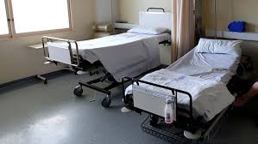
Handling and Laundering Soiled Linens
Handle all contaminated linens with minimum agitation to avoid contamination of air, surfaces, and persons
Do not sort or rinse soiled linens in patient-care areas
Use leak-resistant containment for linens contaminated with blood or body substances; ensure that there is not leakage during transport

Slide 31
Waste Disposal
Puncture-resistant, leak-proof sharps containers are located in every patient-care area (e.g., exam room, chemotherapy suite, phlebotomy station)
All sharps are disposed of in the designated sharps container; do not bend, recap, or break used syringe needles before discarding them into the container
Filled sharps containers are disposed of in accordance with state regulated medical waste rules
Regular trash and regulated medical waste (e.g., biohazardous material and chemical hazardous waste, including antineoplastic drugs) are disposed of in their designated containers
All trash and waste containers are emptied at least daily by designated personnel
Handle, transport, and dispose regulated waste, including antineoplastic and hazardous drugs, in accordance with state and local regulations

Slide 32
Summary
Infection control prevention is the responsibility of everyone at West Cancer Center.
Protect yourself as well as your patient
If in doubt, ask questions.

