Slide 1
Ensuring a Safe Environment at
Work

Slide 2
West Cancer Center is committed to Your Safety and the Safety of our Patients
By complying with several regulatory agency guideline We ensure that we promote the safest environment of care possible.
Agencies
  Occupational Safety and Health Administration (OSHA) : responsible for ensuring that organizations provide a safe environment for their employees. Tennessee OSHA (TOSHA) is the agency that governs the State of Tennessee.
  The Joint Commission: an accreditation agency that conducts surveys for all hospitals that receive Medicare funding. The purpose of the survey is to evaluate the organization’s compliance with nationally established standards of care.

Slide 3
You have a right to a workplace with no recognized hazards.
When you recognize a potential dangerous work related issues, you should talk with your supervisor about unsafe conditions.
  You have a right to equipment which makes your job safer.
If reported hazards remains unresolved, you have the right to report the unsafe condition to Human Resource Department without fear of reprisal or punishment.

Slide 4

Reporting Unsafe Conditions
Any unsafe conditions or issues must be reported to your supervisor immediately.
You do have the right to report unsafe conditions and/or concerns to The Joint Commission and OSHA.
  The Joint Commission One Renaissance Blvd Oakbrook Terrace, IL 60181 1-800-994-6610
  Tennessee Occupational Safety and Health Administration (TOSHA) 220 French Landing Drive Nashville TN 37243 1-800-249-8510 or 615-741-2793

Slide 5

Reporting Associate Injuries
Some injuries are un-avoidable.
If you get injured on the job, contact your supervisor immediately and report the injury.

Slide 6
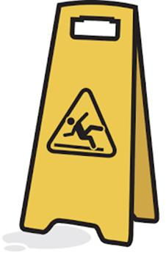
Be Mindful of Hazards in Your Environment
Correct hazards if you can, i.e. clean up small, non-hazardous spills
Report unsafe environments or conditions to your supervisor

Slide 7
Reporting Occurrences
An occurrence is an event that causes injury or death to a patient, visitor, contractor, or other person - NOT AN ASSOCIATE
Examples of an Occurrence
  A visitor slips and falls on our property
  A medical device causes harm to a patient
  A contractor gets hurt while working on our campus
  • A patient falls out of a wheelchair or bed
  A medication error or a near miss in medication administration

Slide 8
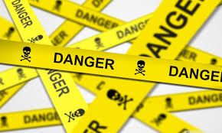
Specific Types of Hazards

Slide 9
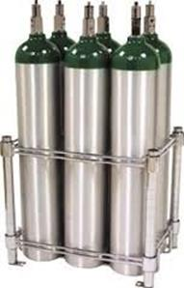
Handling and Storing 02 Cylinders
Oxygen Cylinders must be properly stored and racked
Never place E cylinders directly on the floor or not racked properly
Never place E cylinders on top of a bed to transport
Do not carry E cylinders over your shoulder
Never ask a patient to hold or transport the 02 cylinder for you

Slide 10
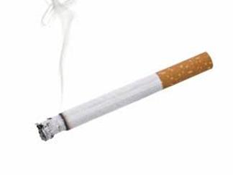
Smoking is not allowed on any West Cancer Center property

Slide 11

Preventing and Reacting to Fire
When You Hear the Fire Alarm
  Respond immediately even if it is not in your area:
  Clear all hallways and exits of clutter
  Close all doors
  Do not block exits, pull stations, fire extinguishers, or fire hose cabinets
Rescuing patients in immediate danger is your first priority
Pull the fire alarm whenever you suspect fire or when you see or smell smoke
Close all doors, windows, and vertical openings such as laundry chutes
If you cannot extinguish the fire, evacuate the area
DO NOT enter a room that you suspect has a fire in it or that is filled with smoke

Slide 12
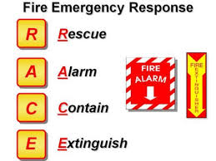
If a fire is in your area “RACE” into action

Slide 13
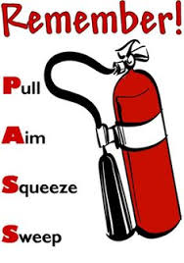
Know where the fire extinguishers are located in your area!
On your 1st day of the job, ask your supervisor to show you the nearest fire extinguisher and fire pulls.
Pull the pin located between the two handles
Aim the nozzle at the base of the fire
Squeeze the handles together
Sweep the extinguisher from side to side

Slide 14
More tips about Fire Extinguishers
Keep your back to the door when extinguishing a fire so you can leave safely
Extinguishers and pull stations can be found near all exits
When extinguishing a fire, continue to apply extinguishing agent after the fire appears to be out
Stay with an extinguished fire until the fire department arrives
Only special types of fire extinguishers are allowed near the MRI.

Slide 15

When evacuating
Use Stairwells not elevators to evacuate

Slide 16
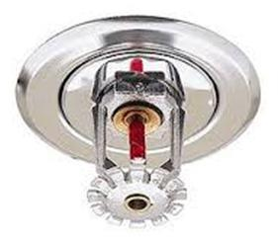
Do not block sprinkler heads
Boxes and supplies must be at least 18 inches from the ceiling
Sprinkler head covers should be intact
Ceiling tiles act as a smoke and fire barrier
Ensure ceiling tiles are intact (if so contact Facility Services)
  No missing tiles
  No holes or cracks
  No stains

Slide 17

Using Electrical Equipment Safely
Because electricity is everywhere, it is often ignored as a very real threat to your personal safety.

Slide 18

Electrical Safety Tips
Make sure you receive training on any type of equipment before using it
Do not attempt to unplug an item if standing water exists
Make sure you know how to use electricity safely!
Never use a “cheater” to convert a 3-pronged plug into a 2-pronged plug.
DO NOT overload electrical sockets

Slide 19

More tips on Electrical Safety
Make a habit of checking for frayed or damaged cords before plugging in equipment
Immediately tag and remove devices with damaged cords from service, then notify your supervisor
Keep electrical cords clear of traffic
Do not conceal cords under rugs
The correct way to unplug electrical equipment is to grasp the plug and then pull; never yank the cord
Extension cords are not allowed unless they are provided by Facilities Services

Slide 20
Even More about Electrical Safety
Notify Facilities Services if ANY outlet cover is cracked, damaged or missing
Turn off coffee makers or other appliances when not in use
Only approved coffee makers and microwaves are allowed
Toasters and toaster ovens are strictly prohibited
Space heaters, electric fans, candles, electrical decorative lights are strictly prohibited and are not allowed in any West Cancer Center locations.
Paper Holiday decorations must be flame retardant

Slide 21
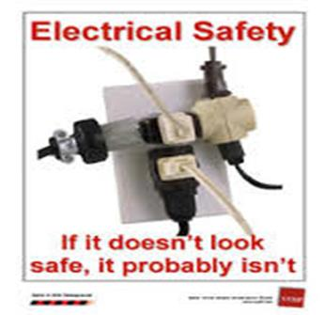
If you detect a potential electrical hazard:
Take steps to eliminate any immediate danger
Promptly notify your supervisor
Contact Facilities Services

Slide 22
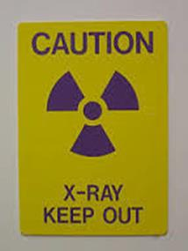
Radiation Safety
Under normal circumstances, radiation exposure levels associated with the healthcare environment are extremely low and safe.
Some Tips
  Unless authorized, avoid areas or objects containing the international radiation warning symbol.
  Pregnant Associates should avoid any exposure to radiation throughout their full term.
  Non-essential Associates should not be present in the area when x-ray is being used
  Mechanical devices should be used for holding patient film cassettes during x-ray exposure when possible
  A radiation monitor/film badge must be worn by Associates who work with or around radiation

Slide 23
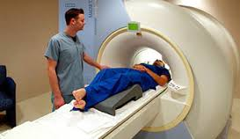
Magnetic Resonance Imaging (MRI) Safety
All MRI scan areas are restricted areas.
No one may enter without: –
  The knowledge and supervision of the MRI staff,
  Undergoing screening for metal objects
No metal object can be taken in the room unless it is known to be safe

Slide 24
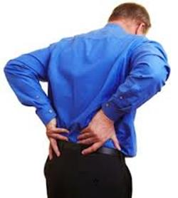
Back Injuries
Back injuries are the number one work related injury.
Most back injuries are not caused by a single incident.
Back injuries are usually caused by improper lifting, sitting, pulling, etc. and gradually occur… O v e r T i m e!

Slide 25
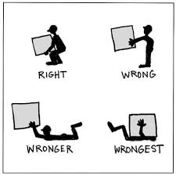
Safe lifting is important…Not only to prevent back injuries, but also to prevent injuries to other body parts such as wrists, arms, elbows, shoulders, and neck.
Twisting while lifting can be a serious error. It alters the natural curve of the back and puts greater strain on the back muscles.

Slide 26

Safe Lifting Techniques
Get assistance when the load is too heavy or large
When you are ready to lift, stand with your feet slightly apart
Bend your knees instead of instead of your waist
Lift with your legs- back straight legs bent
Keep the load close to your body and avoid twisting. Make sure you can see over the load.
The further the load is from you, the greater the strain on your back

Slide 27

Pushing & Pulling
Stay close to the load
Use both arms
Look before pushing cart or heavy object into corridor
Push rather than pull whenever possible

Slide 28
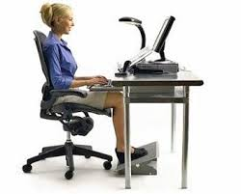
Office Ergonomics
Adjust height, back and arms of the chair
Make sure your feet are flat on the floor
Adjust computer display
Adjust lighting
Consider your posture & readjust
Get up from sitting often

Slide 29
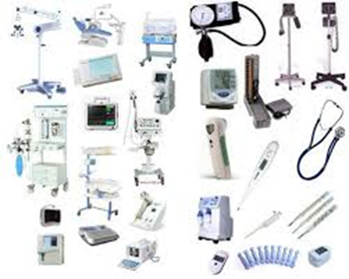

Safe Medical Devices Act (SMDA)
The Safe Medical Devices Act (SMDA) is a federal act designed to assure that all medical devices are implemented safely
A medical device is anything used in patient care except drugs such as
  IV pumps, monitors, or blood filter,
  syringes, gloves, or catheters
  instruments such as scissors, hemostats, or clamps

Slide 30
What is the Associate’s/Physician’s Responsibility in the Event of an SMDA Occurrence?
Attend to any immediate medical and safety needs of the patient or other involved individuals
Remove the device from service and label it as defective
Complete report
Associates may voluntarily report an SMDA event. By calling 1-800-FDA-1088.
You can also report by completing or mailing an FDA form which can be downloaded from www.fda.gov/medwatch The form can then be mailed in or faxed to 1-800-FDA-0178.

Slide 31
Disposing of Medical Equipment
Any medical equipment that will be disposed of or donated must be reported to Facility Services to be processed out of the West Cancer Center system.
This is to ensure we depreciate the equipment, take it out of our inventory, and secure any legal documents for donating equipment.

Slide 32

What are Hazardous Materials?
Any material or chemical that causes acute health problems, death or chronic illness.
Is flammable
Is reactive
Contains blood or body fluids
Is identified by the label as a hazardous material

Slide 33

Hazard communication is a method of:
Warning you about the potential hazards of workplace chemicals
Letting you know how you can protect yourself against the possible risks associated with these chemicals Including
Physical and health hazards
Personal protective equipment necessary during handling or cleanup
Emergency procedures – handling, cleanup, and disposal instructions

Slide 34

Material Safety Data Sheets (MSDS)
A Material Safety Data Sheet (MSDS) is a document that contains information on the potential health effects of exposure to chemicals, or other potentially dangerous substances, and on safe working procedures when handling chemical products.
Warning Labels, and Material Safety Data Sheets (MSDS) which is found on the WCC Intranet/MollI

Slide 35
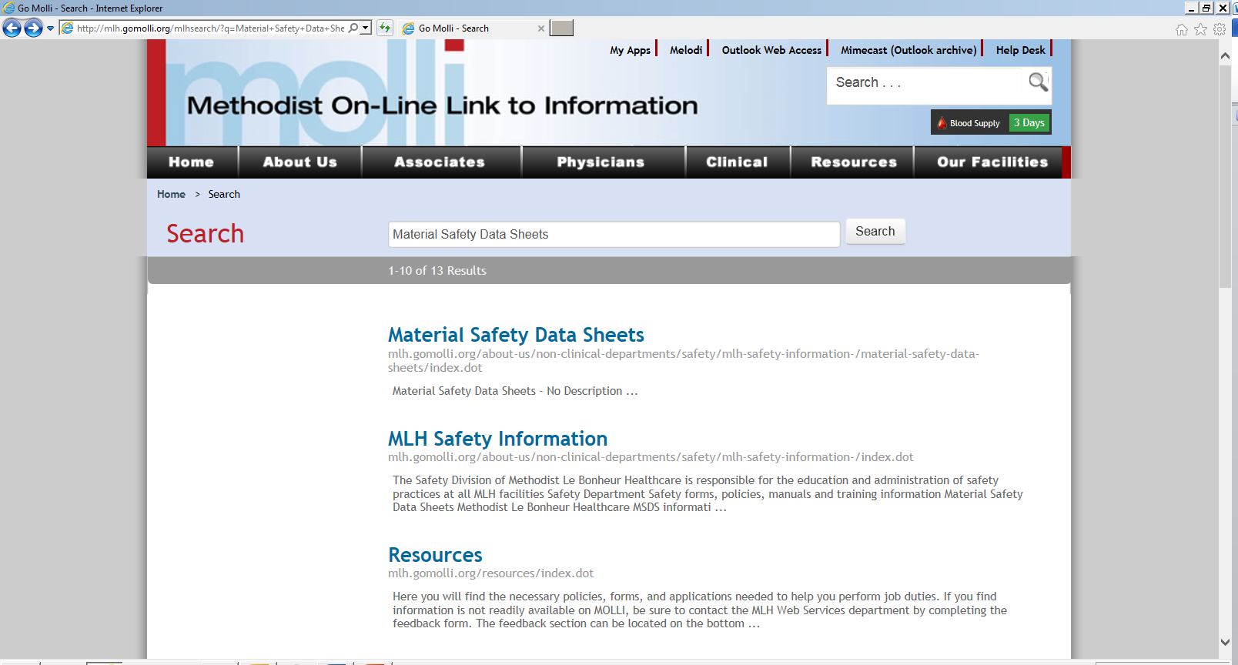

Slide 36

System/Utility Failure - Power/water/phone
Remain calm and provide assistance to others if necessary.
Obtain emergency kit, or emergency lighting
Ensure the safety of patients, visitors, and Associates
Move to a lighted area
Contact Facility Services (facility specific)
Consider Evacuation of the area if outage will be long term.
Use stairs only

Slide 37
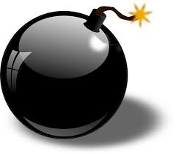
Bomb Threat
Keep the caller on the line
If possible , signal for someone to call Security (Facility specific) or local police or 911.
Obtain as much information as possible and write it down
  Time of bomb to detonate
  Listen for any accent of callers voice, speech impediments
  Listen for background noise such as trains, traffic, bells.
Begin evacuation of the area
Once security/police respond, follow their direction

Slide 38
Violent/Armed Individual-Active Shooters
If the incident is occurring on your unit or general area:
  R: Recognize that the event is occurring (stay calm, Alert others).
  E: Evade the shooter (take shelter and hide – Do Not Try to reason with the shooter).
  T: Take all necessary precautions. (Silence phones Pagers, computers, radios.)
  R: Remain hidden. (Do Not comes out of hiding! Stay Away from windows.)
  E: Escape only if possible.
  A: Attend to the wounded after the incident is cleared.
  T: Talk to onsite counselors for a debriefing following
If the incident in an open/public area (lobby, waiting area) or if escape is not possible:
  C: Close all doors on the unit.
  H: Hide or barricade yourself in an area and do not Move until incident is cleared.
  I: If possible, take others with you to seek refuge.
  L: Listen for updates from the operator.
  D: Do Not come out of hiding until the incident is Cleared by the Police.
Do Not opens the door if there is any doubt of safety.
Call 911/ Facility’s Security

Slide 39
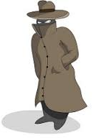
Suspicious Person
Do not physically confront the person
Do not let anyone into a locked building or office
Call Security (facility specific numbers) or 911
Provide as much information as possible about the person their direction of travel
Alert others to stay clear of the area
Secure your area

Slide 40

Suspicious Package
What to Do When You Have a Suspicious Letter or Package
Do not touch or disturb the object.
Do not shake or empty the contents of the
Envelope or package.
Call Security (facility number) or 911
Do NOT use a cell phone near the package!
Be prepared to evacuate.
LEAVE THE PACKAGE OR ENVELOPE WHERE IT IS.
LEAVE the room, close the door, contact Security, and do not let anyone in the area.
Wash your hands with soap and water.
List all people in the area at the time the package or letter was recognized. Give this list to Security.
What to Do if the Package or Envelope Is
  Covered With Powder or Spill
  DO NOT try to clean up the powder. COVER the contents immediately with anything (e.g., clothing, paper, trash can, etc.) and DO NOT REMOVE THIS COVER!
  Leave the room, close the door, contact Security and do not let anyone in the area.
  Wash your hands with soap and water.
  Remove heavily contaminated clothing as soon as possible and places them in a plastic bag, or a container that can be sealed. You can double-bag the items. This bag needs to be given to emergency responders.
  Shower with soap and water as soon as possible. DO NOT USE BLEACH OR OTHER DISINFECTANT ON YOUR SKIN.
  List all people who were in the room or area, especially those who had actual contact with the package or envelope. Give this list to Security.

Slide 41
Out of Control Person
C-Call security (facility) Call 911
O-Observe activity
L- location must be provided to Security and 911
D-Describe activity and person
Hostage situation
Call 911/ Facility Security & give exact location
Maintain a safe distance
Give identification of all persons involved in hostage situation
Any pertinent information relative to the development of the situation
Description of the aggressive person
Any special situation or circumstances that would increase the danger to patients, visitors, or Associate safety

Slide 42

Missing Child/Adult
Contact local law enforcement 911, and Security.
Give description of the missing child or adult, the location of the abduction (last seen area)
If known, give description of the suspected abductor
Go to the nearest entrances and exits
Go to the stairwell
Watch for suspicious behavior
Watch for person fitting the description or suspected abductor
description
Stop anyone carrying a box or bag big enough to hold a child.
Remain at your post until an official “All Clear” has been
announced overhead

Slide 43

Earthquake
If inside
Remain inside
Move away from windows
Move away from tall shelves and other objects that may fall on you
Watch for falling objects such as light fixtures or ceiling tiles
Get under strong table, counter, or desk if you are able
Do not stand in a doorway
Do not leave the area without reporting to you supervisor

Slide 44
Earthquake
If outside
Move away from buildings
Move away from electric power lines
Get inside a building if possible
Avoid overhanging structures
Avoid power line
After an earthquake
Watch for broken glass
Check for people that may be trapped
Call 911 for those who need immediate medical assistance
Check for fires
Do not touch electrical wires
Obtain emergency kits

Slide 45
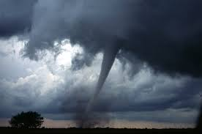
Severe Weather -Tornado
If you hear tornado sirens:
  Close all drapes, blinds or outside windows
  Close all doors
  Stay away from large areas of outside glass
  Move to interior parts of the building
Be alert that you may loose power or have structural damage
Move to lower levels of the building (first floor or basement)
Obtain emergency kit/emergency lighting
Account for all patients, visitors and Associates
If damage occurs contact Facility Services

Slide 46

Your next step
Complete the quiz at https://www.classmarker.com/online-test/start/?quiz=6br56f06736b6e83
You must score at least 90%
Submit your certificate to Human Resources

